Slide 1
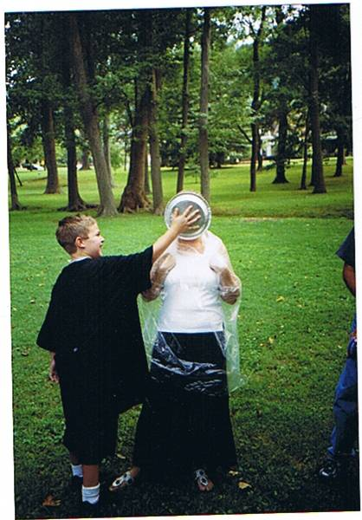

Slide 2
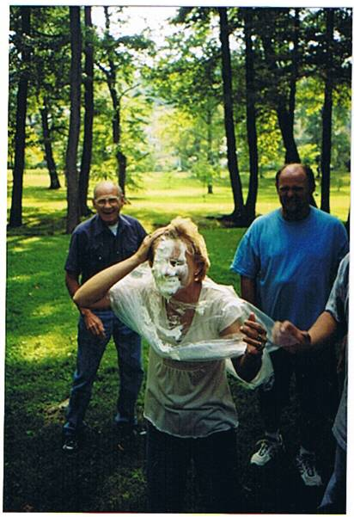

Slide 3
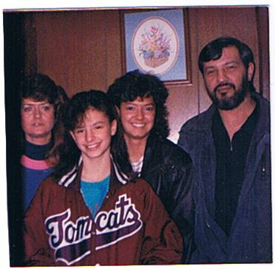
Joh, Jane, Jennifer, Sam - 1990

Slide 4
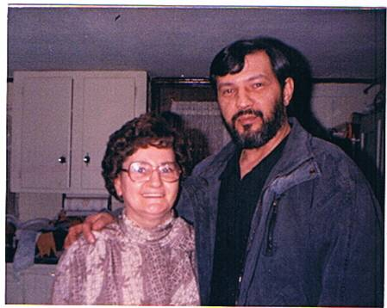
Aunt Harriet & John 1990

Slide 5
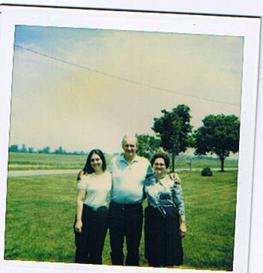
Bill, Harriet, Mary Lou-1986

Slide 6
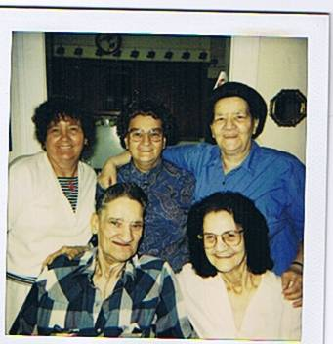

Slide 7
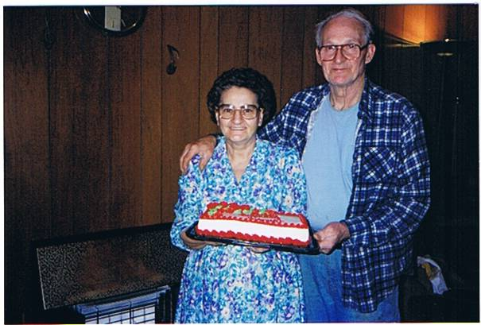
Harriett & Bill, March 29, 1996 64th Birthday

Slide 8
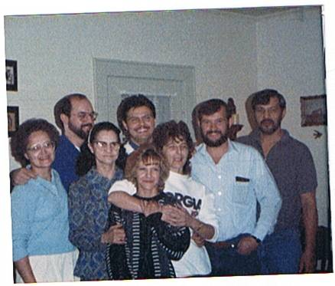

Slide 9
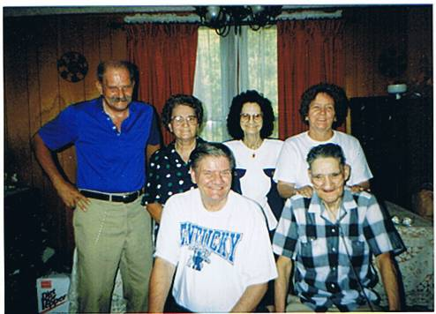

Slide 10
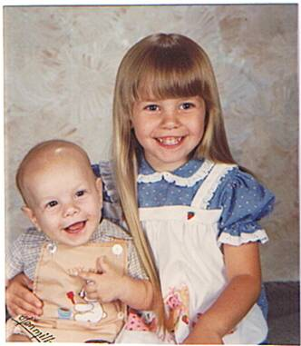
Jamie ( 5 ) & Tony Maynard ( 5 months)

Slide 11
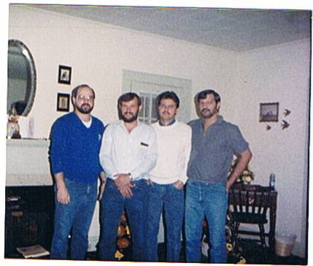
Maynard Boys (Nov-1989)

Slide 12
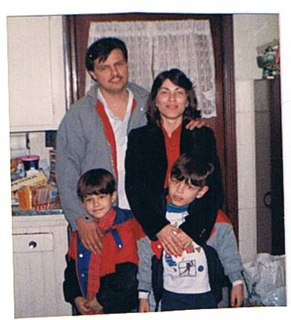
Mark, Joann, Herbie, JJ (Feb. 1990)

Slide 13
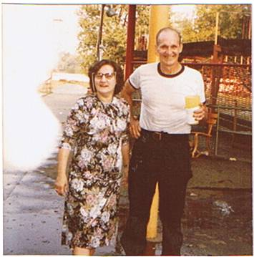
Bill & Harriett ( 1978)
Dress Mom was buried in

Slide 14
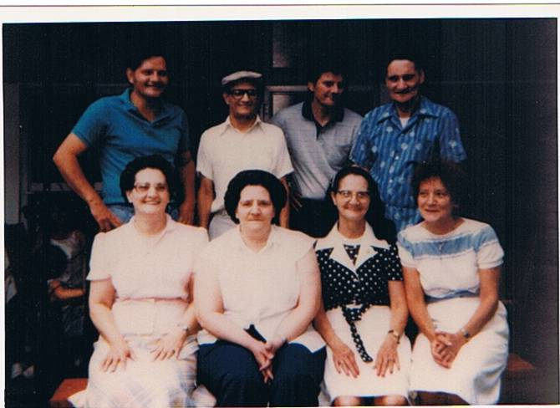
Charles (45), John (58) Carl (48) Tossie (56) Harriett (52) Lucille (54) Elizabeth (60) Dorthy (49)

Slide 15
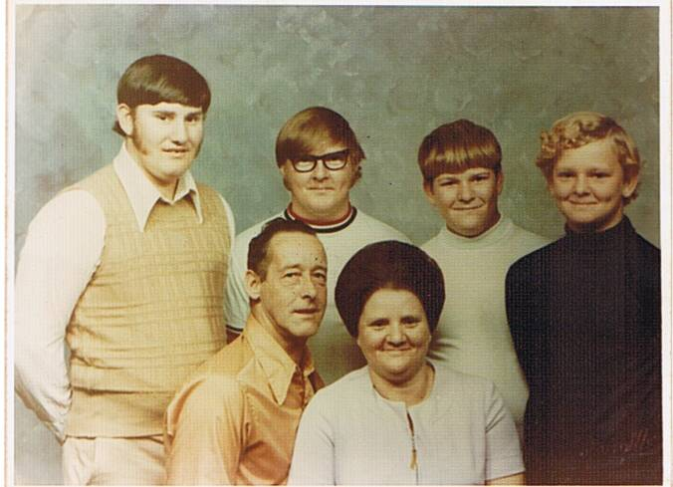
Betty & Donald Castle ( Donnie, Gary, Art & Darryll )

Slide 16
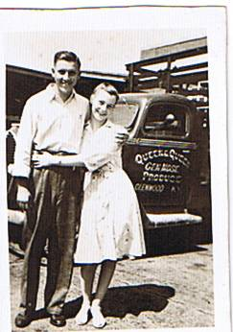
Dock Jr. & Dorthy Dove

Slide 17
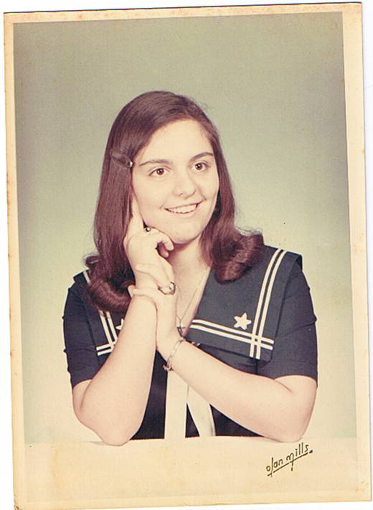
Mary Lou ( 1969- 14 years)

Slide 18
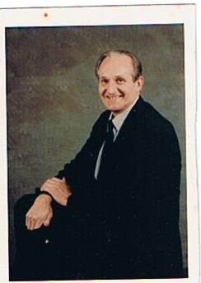
Uncle Bill Sarven 1983

Slide 19
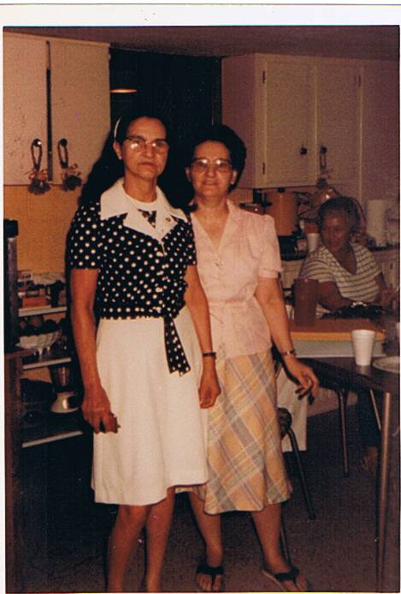
Elizabeth & Harriet July 1984

Slide 20
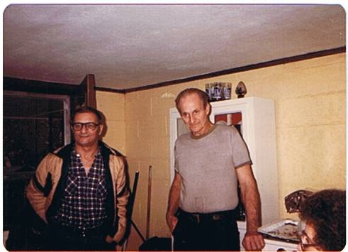
John Dove & Bill Sarven ( Nov 1983 )

Slide 21
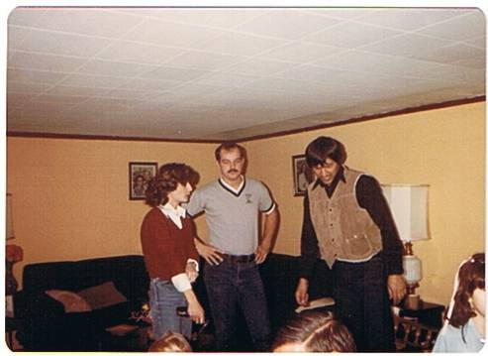
Jerry, Mark, Bobbie July-1984

Slide 22
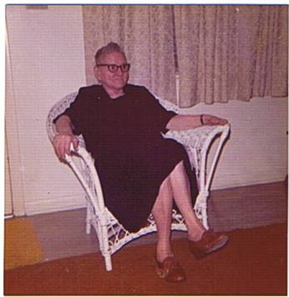
Mrs. Mabel Dove - 1974

Slide 23
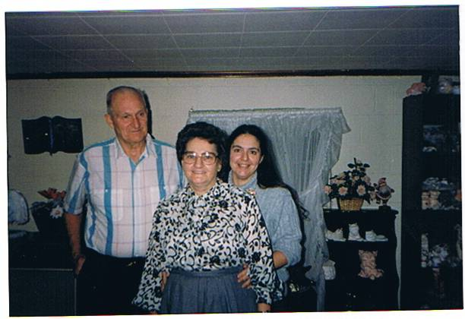
Bill Harriet & Mary Lou 1991

Slide 24
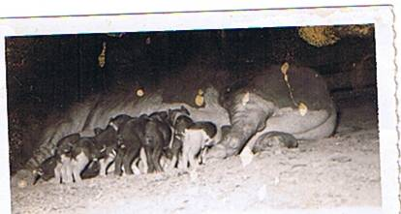
Bill & Harrietts Hog

Slide 25
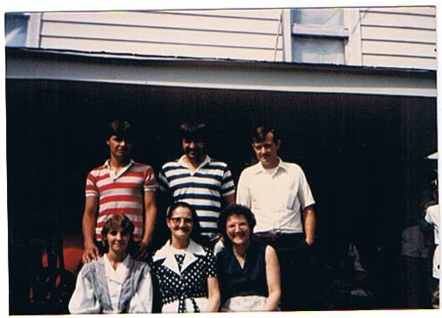
July 1984

Slide 26
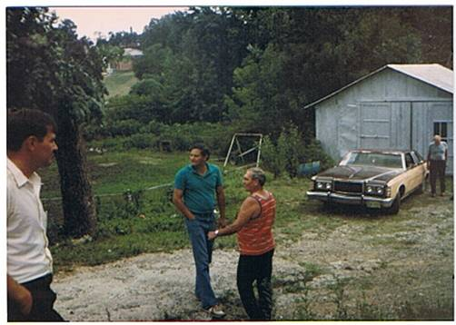
Arnold Jr., Charlie Dove & Edmon Staggs Back-Bill Sarven (July 1984)

Slide 27
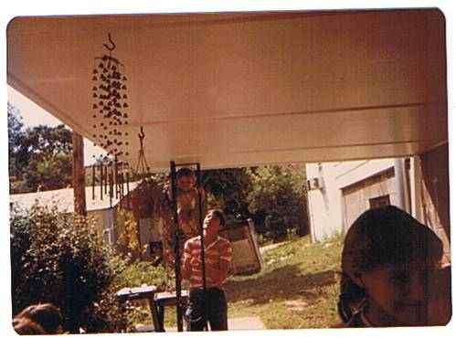
Herbie climbing porch, Mark & Libby (Dove Reunion July 1984)

Slide 28
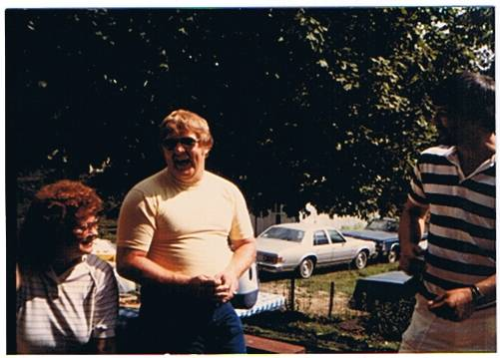
Debbie, Gary Castle, John Maynard ( July 1984 )

Slide 29
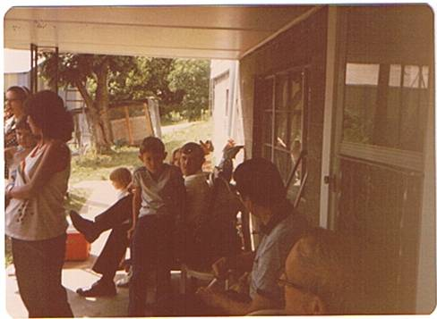
Elizabeth, Joann & Herbie, Arnie & Arnold Carl Dove ( Dove Reunion July 1984)

Slide 30
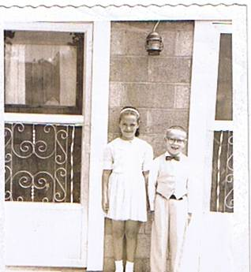
Mary Lou Sarven & Gary Ray Castle (1962) Both are seven years old..Mary Lou is two months older…

Slide 31
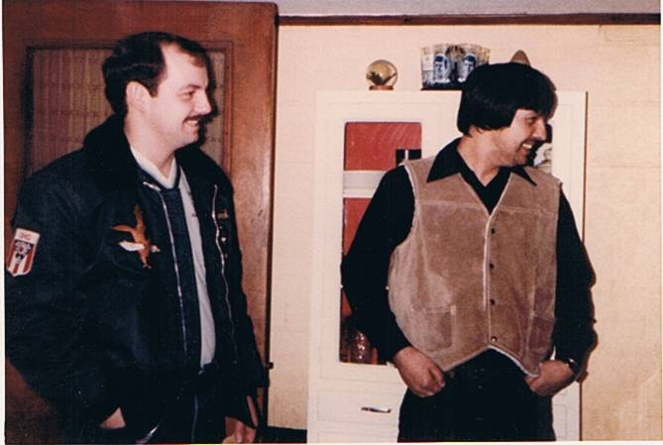
Jerry David & John Allen Maynard 1983

Slide 32
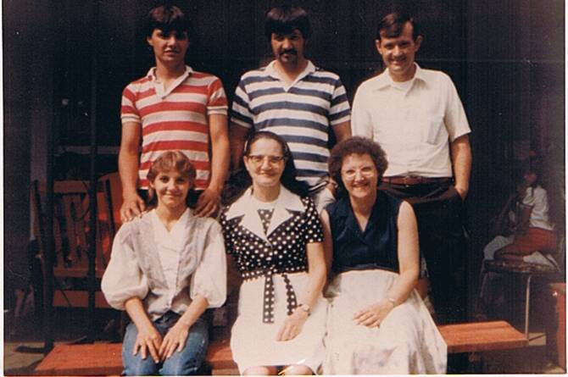
Mark, John, Arnold Libby, Elizabeth and Frankie July 7, 1984

Slide 33
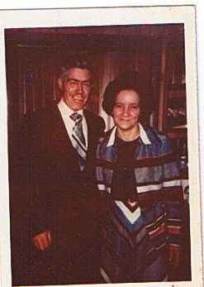
Dottie & Ray Keeton (March 1979)

Slide 34
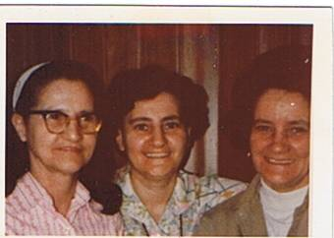
Elizabeth, Harriett and Dorthy ( April 1979 )

Slide 35
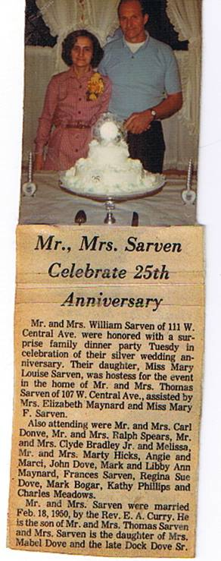

Slide 36
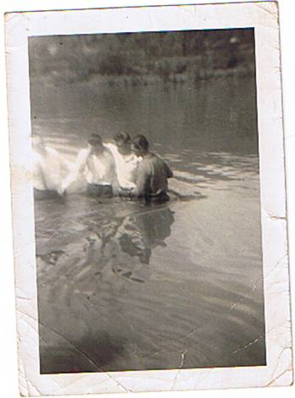
Bill Sarven *& “Duddle” Maynard being baptized in May 1949 by Rev. Curry & Arnold Maynard

Slide 37
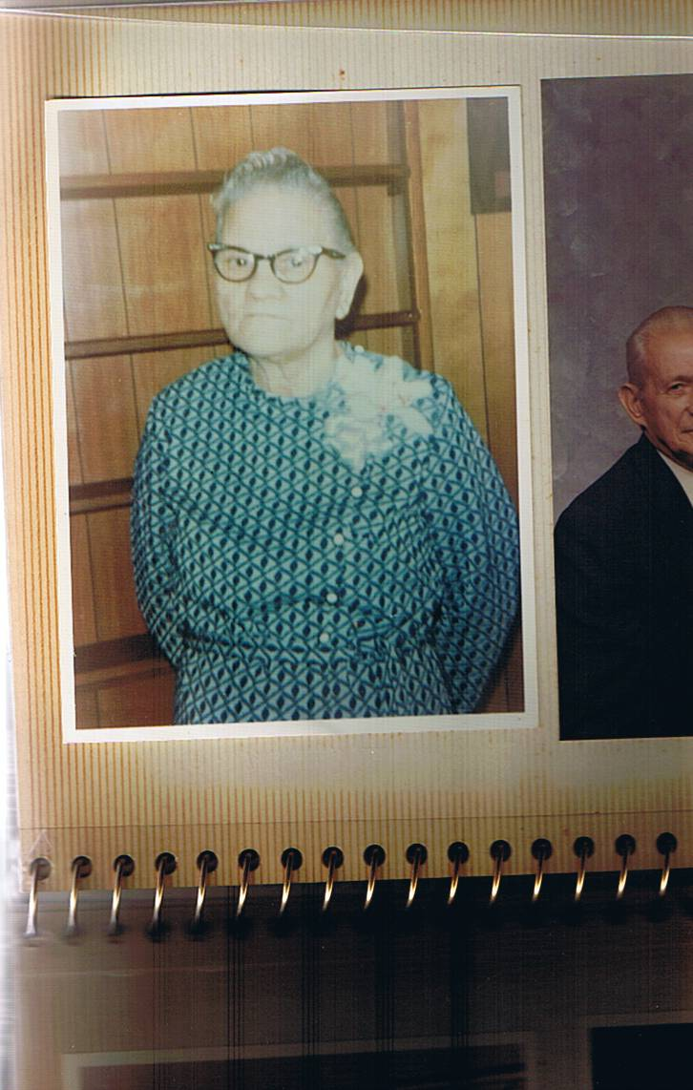

Slide 38
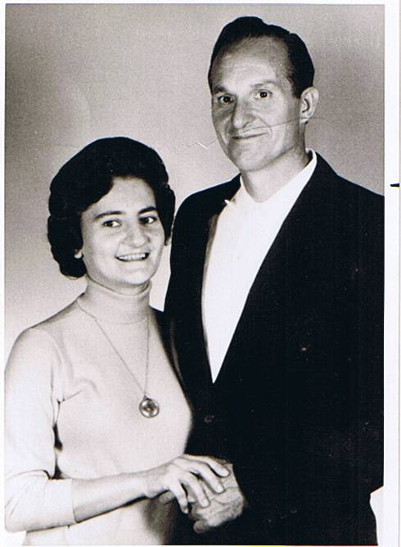
Bill & Harriett Sarven 20th Anniversart 1970

Slide 39
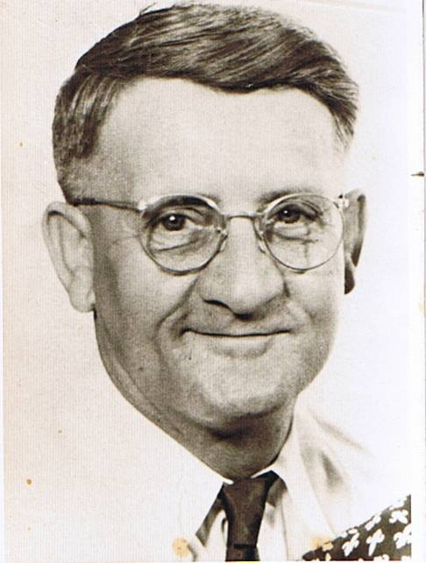
Dock Dove July 1954 ( Dec. 27,1896 )

Slide 40
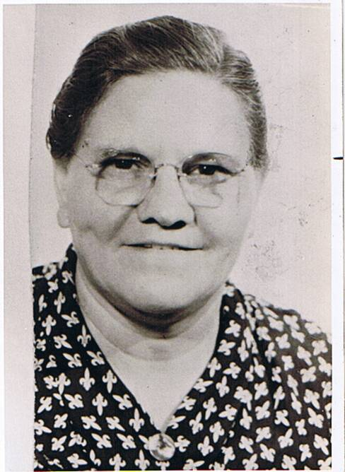
Mabel Dove July 1954 ( March 21, 1901)

Slide 41
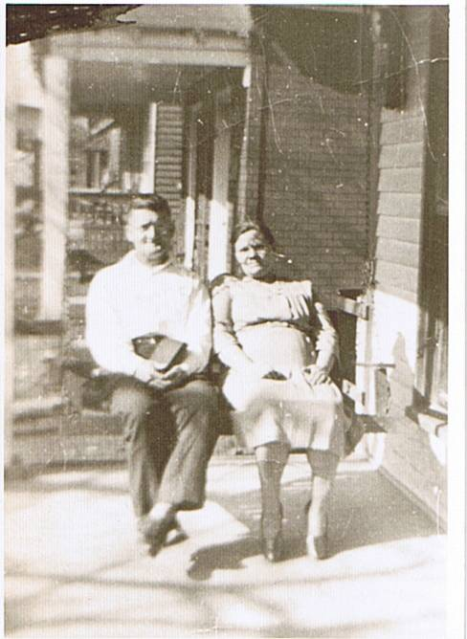
Dock & Mabel ( 1954)

Slide 42
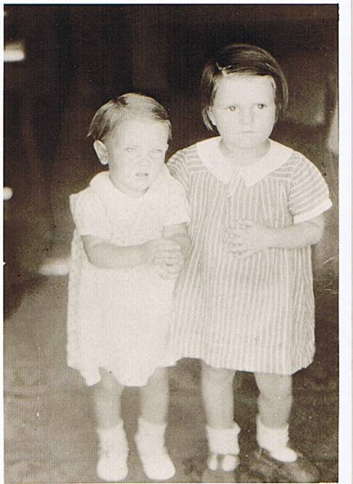
Betty Jo – 4years old Dottie Dove 3years old

Slide 43
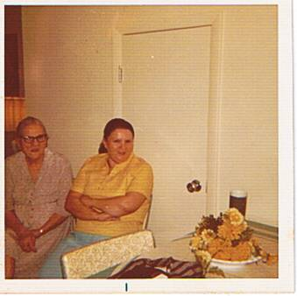
Mabel Dove &Betty Castle - 1973

Slide 44
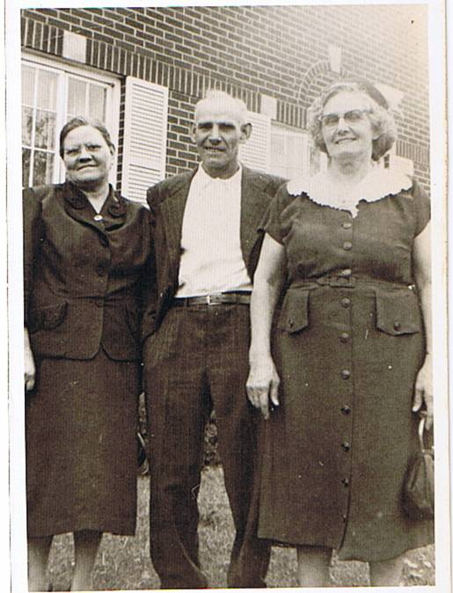
Mabel Anderson Dove Charles Anderson Mary Anderson Bandy

Slide 45
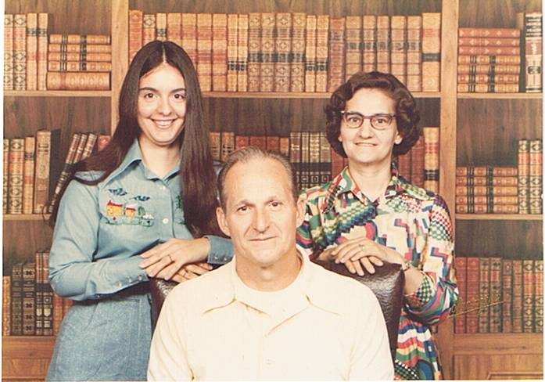
Bill, Harriet, Mary (June 1976) Mary 21, Bill 46, Harriett 44

Slide 46
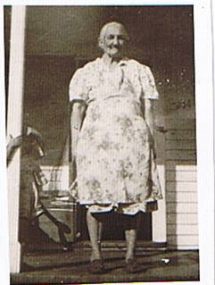
Grandma Freeman ( Minnie Bowen Anderson Freeman) Elizabeth’s grandmother, Arnolds great grandmother

Slide 47
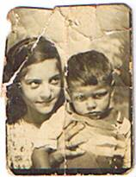
Elizabeth and Carl Dove

Slide 48
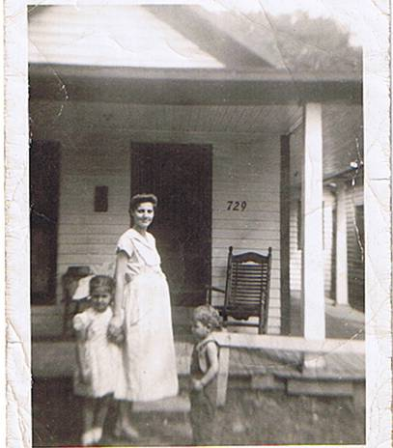
Elizabeth, Frankie, Arnold Jr.

Slide 49
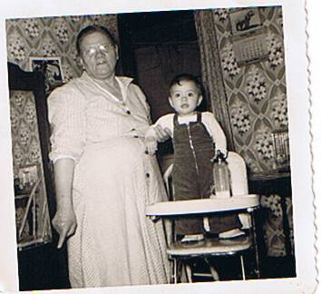
Mamaw Dove & Mary Lou ( December 1955 )

Slide 50
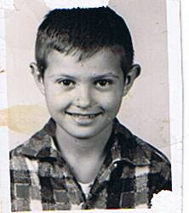
Arnold Jr.

Slide 51

Elizabeth, Frankie, Arnold Jr, John, Barbara Lee

Slide 52

Doc Dove

Slide 53

Bill holding Bobby Lee & Chuckie, Frankie holding Donnie…Sitting on ground Buddy, June Bug (Arnold Jr) & Johnny

Slide 54

Tossie and Lavern

